Slide 1


Adarsh K
2023/05/22

Slide 2

Outline
Executive Summary
Introduction
Methodology
Results
Conclusion
Appendix

Slide 3
Executive Summary
The following methodologies were used to collect, and analyze data
Data collection using SpaceX API and Web scraping.
Exploratory Data Analysis (EDA), data wrangling, data visualization, and interactive visual analytics (dashboards)
Machine Learning – Prediction.
Summary of all results
Valuable data was collected from public sources.
EDA provided a way to identify features which were best to predict the success of launches.
Machine Learning performed on collected data revealed the best model to predict the characteristics which are important to drive opportunities in the best possible way.

Slide 4
Introduction
Objective
Evaluate the viability of a new company SpaceY to compete with SpaceX
Desirable results
Estimate the total cost for launches, by predicting successful landings of the first stage of rockets.
Analyze the sites used for launching rockets.

Slide 5

Section 1

Slide 6
Methodology
Executive Summary
Data collection methodology:
Data for SpaceX Falcon9 launches were collected from 2 sources:
SpaceX REST API (https://api.spacexdata.com/v4/launches/past)
WebScraping (https://en.wikipedia.org/wiki/List_of_Falcon/_9/_and_Falcon_Heavy_)
Perform data wrangling
Collected data was cleaned, added a landing outcome label based on the outcome data after summarizing and analyzing features.
Perform exploratory data analysis (EDA) using visualization and SQL

Slide 7
Methodology
Executive Summary
Perform interactive visual analytics using Folium and Plotly Dash
Perform predictive analysis using classification models
Cleaned data collected until this stage was scaled using StandardScaler.
Scaled data was then split into training and testing datasets.
Four different classification models – Logistic Regression, Support Vector Machines (SVM), Decision Trees, and k-Nearest Neighbors (kNN) were trained using the training dataset, and tuned hyperparameters obtained using cross validation technique GridSearchCV.

Slide 8
Data Collection
Data was collected from two sources
SpaceX REST API (https://api.spacexdata.com/v4/launches/past) and
WebScraping (https://en.wikipedia.org/wiki/List_of_Falcon/_9/_and_Falcon_Heavy_)

Slide 9
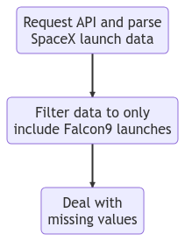
Data Collection – SpaceX API
SpaceX offers a public API from where the data can be obtained and used.
Refer to the flowchart to understand the data collection process.
Source code

Slide 10
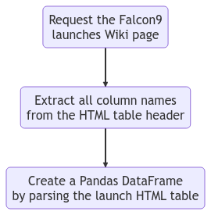
Data Collection - WebScraping
Data of SpaceX launches can also be obtained from public sites like Wikipedia.
Refer to the flowchart to understand the data collection process.
Source code

Slide 11
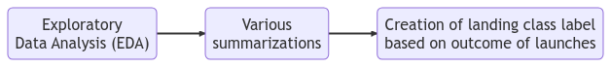
Data Wrangling
Exploratory Data Analysis (EDA) was performed on the dataset.
Then the summaries of launches per site, occurrence of each orbit type, occurrence of mission outcome per orbit type, and success rate of launch sites were calculated.
Finally, a landing class label was created based on the outcome of the launch.
Refer to the flowchart to understand the data wrangling process.
Source code

Slide 12
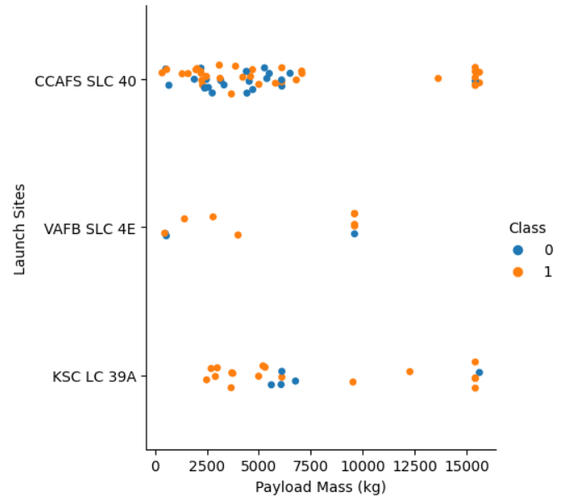
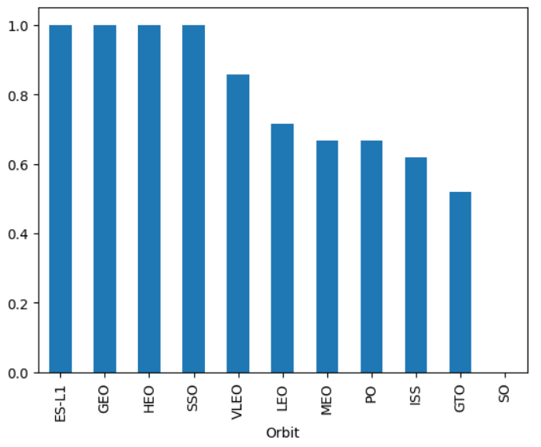
EDA with Data Visualization
To explore and better understand the data, scatter plots and bar plots were used to visualize the relationships between different pairs of features.
Payload Mass x Flight Number, Launch Site x Flight Number, Launch Site x Payload Mass, Orbit x Flight Number, Orbit x Payload Mass
Source code

Slide 13
EDA with SQL
The following SQL queries were performed
Names of unique launch sites.
Five records of launch sites beginning with “CCA”.
Total payload mass carried by NASA (CRS) boosters.
Average payload mass carried by F9 v1.1 boosters.
Date of the first successful landing outcome in ground pad.
Booster names which have success in drone ship and have payload mass between 4,000 to 6,000 kg.
Total number of successful and failure mission outcomes.
Booster names which have carried the highest payload mass, using a subquery.
Failed landing outcomes in drone ship, their booster names, month, and launch sites for the year 2015.
Rank of count of landing outcomes between the dates 04-06-2010 and 20-03-2017 in descending order.
Source code

Slide 14
Build an Interactive Map with Folium
Markers, Circles, Lines and MarkerCluster were used with Folium Maps
Markers indicate points like launch sites.
Circles highlight the area around specific coordinate.
MarkerCluster indicate a group of events in each coordinate, like launches in a specific launch site.
Lines are used to indicate distance between two coordinates.
Source code

Slide 15
Build a Dashboard with Plotly Dash
The following graphs and plots were used to visualize the data.
Percentage of launches by all sites or a specific site (pie chart along with a dropdown to select specific sites)
Payload mass range (scatter plot along with a payload mass slider to select payload mass range)
This combination allowed to quickly analyze the relationship between payload mass and launch sites, helping to identify the best site to launch the rocket.
Source code

Slide 16
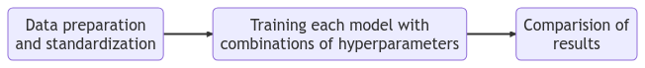
Predictive Analysis (Classification)
Four classification models – Logistic Regression, Support Vector Machines (SVM), Decision Trees and k-Nearest Neighbor (kNN) – were trained on the training dataset, with tuned hyperparameters obtained using cross validation technique – GridSearchCV.
For each model, a confusion matrix was plotted, and accuracy of the model on test dataset was calculated.
Source code

Slide 17
Results
Exploratory data analysis results
SpaceX uses 4 different launch sites.
Customers for SpaceX at the beginning were SpaceX itself and NASA.
The average payload mass is 2,982.4 kg.
The first successful landing (ground pad) occurred in 2018, 8 years after the first launch.
Yearly success rate is trending upwards from 2013 onwards.
Almost all the recent launches have successfully landed.
Drone ship, and ground pad landings have the highest successful landing outcomes respectively.

Slide 18
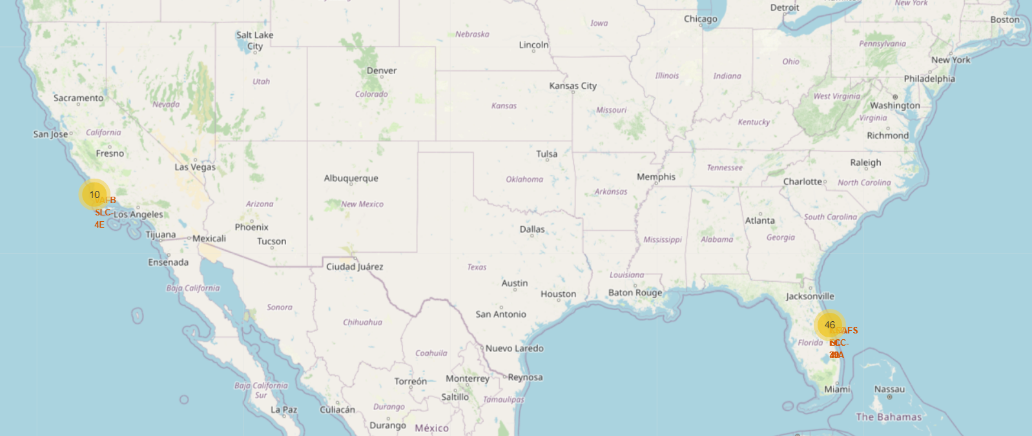
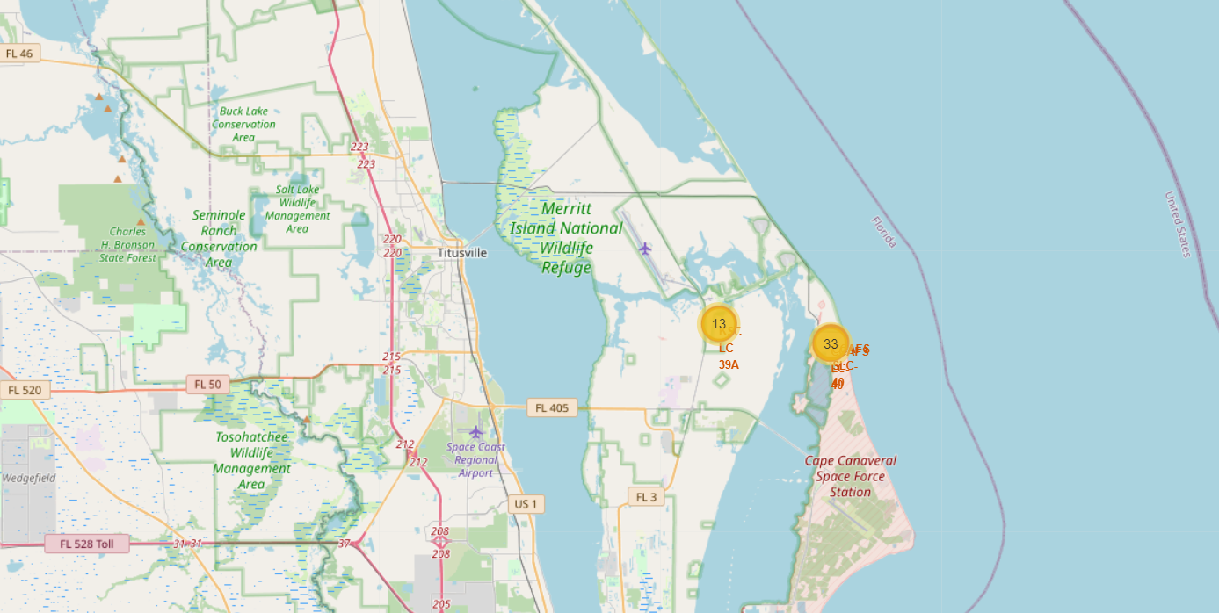
Results
Interactive Analytics show that the launch sites are in safe distance away from cities, closer to coastal sites and have good logistic infrastructure around.
Most launches occur in the east coast.

Slide 19
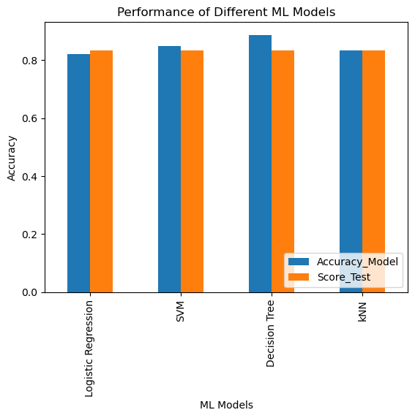
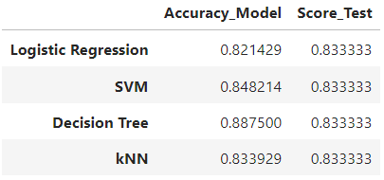
Results
Predictive Analysis showed that Decision Tree Classifier was the best model, having 88.75% accuracy on training set, and 83.33% accuracy on testing set.

Slide 20

Section 2

Slide 21
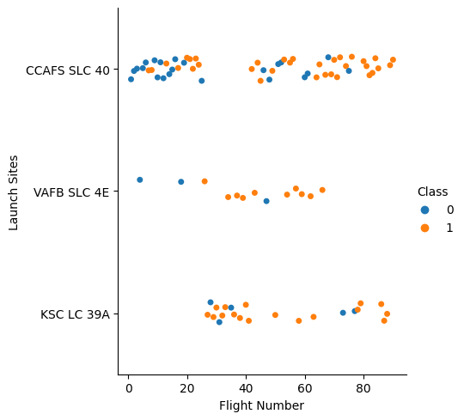
Flight Number vs. Launch Site
From the plot, we can verify that most tests happened at CCAFS SLC 40 site.
The landings failed in the beginning but started to show success over time. Recently all the rockets have been successfully landed.
Tests have been paused at the site VAFB SLC 4E.
KSC LC 39A doesn’t have any records in the beginning, indicating that SpaceX started using the site later on in their space venturing journey.

Slide 22
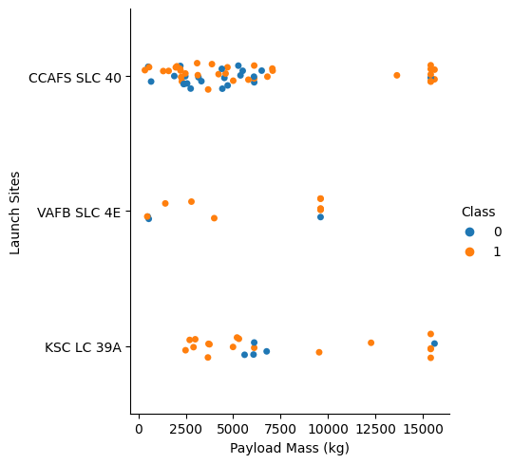
Payload vs. Launch Site
Payloads over 9,000 kg have excellent success rate.
Launching payloads over 12,000 kg seems to be possible only on CCAFS SLC 40 and KSC LC 39A sites.

Slide 23

Success Rate vs. Orbit Type
ES-L1, GEO, HEO, SSO orbit types have almost 100% success rates.
Followed by VLEO and LEO.

Slide 24
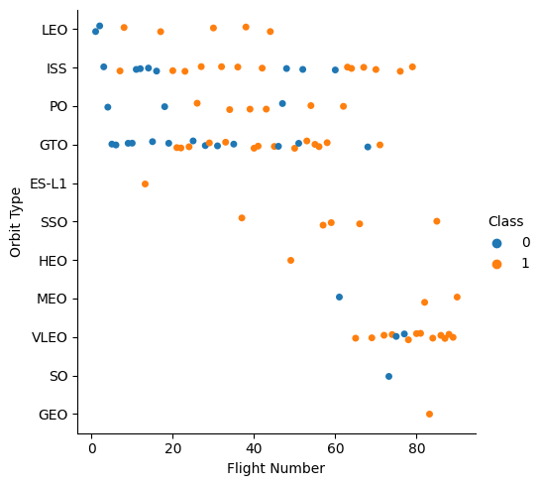
Flight Number vs. Orbit Type
Success rates improved overtime for all orbit
VLEO orbit type seems like a new business opportunity, due to its recent increase in frequency.

Slide 25
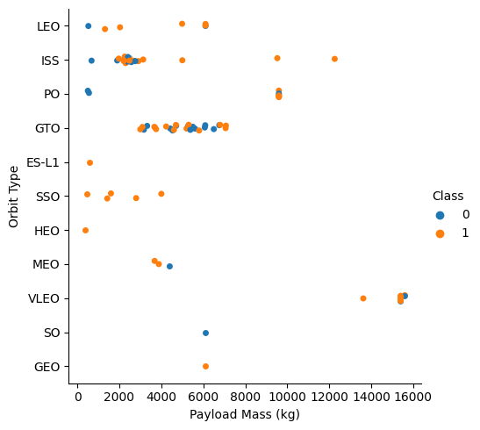
Payload vs. Orbit Type
There is no apparent relationship between payload and orbit for GTO.
VLEO is used to carry high payload masses.
SSO has seen highest number of successes in lower payload region.
ISS has widest range of payload masses.

Slide 26
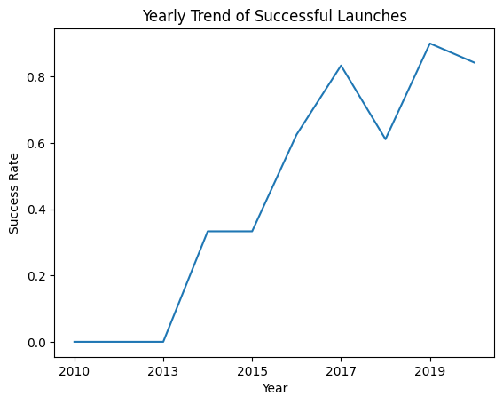
Launch Success Yearly Trend
Success rate keeps increasing until 2020.
First three years were a period for testing and adjustments.

Slide 27
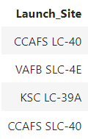
All Launch Site Names
According to the data, there are four launch sites.
They were obtained by selecting unique occurrences of launch sites.

Slide 28
Launch Site Names Begin with 'CCA'
5 records where launch sites begin with `CCA`
Used a condition to specify the structure of launch site string and to display only top 5 records
Date | Time (UTC) | Booster_Version | Launch_Site | Payload | PAYLOAD_MASS__KG_ | Orbit | Customer | Mission_Outcome | Landing_Outcome
06/04/2010 | 18:45:00 | F9 v1.0 B0003 | CCAFS LC-40 | Dragon Spacecraft Qualification Unit | 0.0 | LEO | SpaceX | Success | Failure (parachute)
12/08/2010 | 15:43:00 | F9 v1.0 B0004 | CCAFS LC-40 | Dragon demo flight C1, two CubeSats, barrel of Brouere cheese | 0.0 | LEO (ISS) | NASA (COTS) NRO | Success | Failure (parachute)
22/05/2012 | 7:44:00 | F9 v1.0 B0005 | CCAFS LC-40 | Dragon demo flight C2 | 525.0 | LEO (ISS) | NASA (COTS) | Success | No attempt
10/08/2012 | 0:35:00 | F9 v1.0 B0006 | CCAFS LC-40 | SpaceX CRS-1 | 500.0 | LEO (ISS) | NASA (CRS) | Success | No attempt
03/01/2013 | 15:10:00 | F9 v1.0 B0007 | CCAFS LC-40 | SpaceX CRS-2 | 677.0 | LEO (ISS) | NASA (CRS) | Success | No attempt

Slide 29
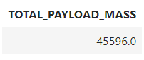
Total Payload Mass
Total payload carried by boosters from NASA (CRS)
Used the aggregate function SUM to calculate the total payload of records where customer is “NASA (CRS)”

Slide 30
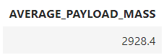
Average Payload Mass by F9 v1.1
Average payload mass carried by booster version F9 v1.1
Used the aggregate function AVG to calculate the average payload mass for the records where booster version is “F9 v1.1”

Slide 31
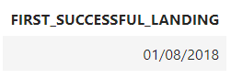
First Successful Ground Landing Date
Find the dates of the first successful landing outcome on ground pad
Used the aggregate function MIN to select the record with the oldest date where the landing outcome was a “Success (ground pad)”

Slide 32
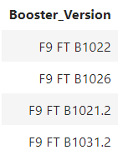
Successful Drone Ship Landing with Payload between 4000 and 6000
List the names of boosters which have successfully landed on drone ship and had payload mass greater than 4000 but less than 6000
Used a WHERE and BETWEEN clause to specify the above-mentioned condition to get the result.

Slide 33
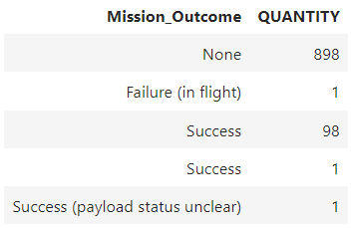
Total Number of Successful and Failure Mission Outcomes
Calculate the total number of successful and failure mission outcomes
This query was obtained after grouping mission outcomes and counting the records within each group.

Slide 34
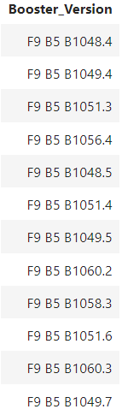
Boosters Carried Maximum Payload
List the names of the booster which have carried the maximum payload mass
Used a subquery with MAX payload mass to get the records.

Slide 35
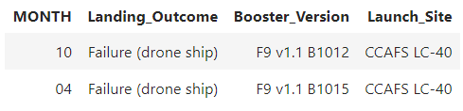
2015 Launch Records
List the failed landing_outcomes in drone ship, their booster versions, and launch site names for in year 2015
Used SUBSTR function to collect the month and constrained the output for the year 2015 and where landing outcome is a “Failure (drone ship)”

Slide 36
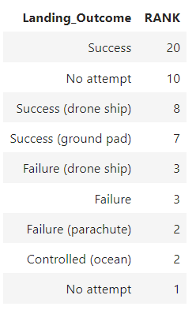
Rank Landing Outcomes Between 2010-06-04 and 2017-03-20
Rank the count of landing outcomes (such as Failure (drone ship) or Success (ground pad)) between the date 2010-06-04 and 2017-03-20, in descending order
Grouped the landing outcome and counted the rows of the groups to calculate rank.

Slide 37

Section 3

Slide 38
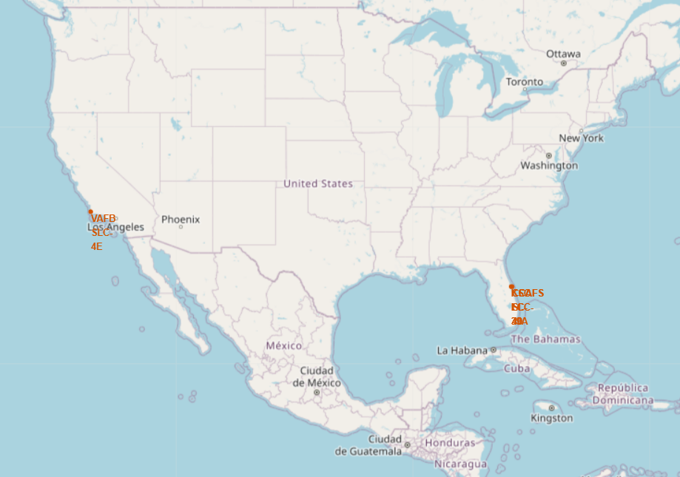
All Launch Sites
All launch sites are near the coast, and relevant logistic infrastructure. Far away from cities, because of safety concerns.

Slide 39
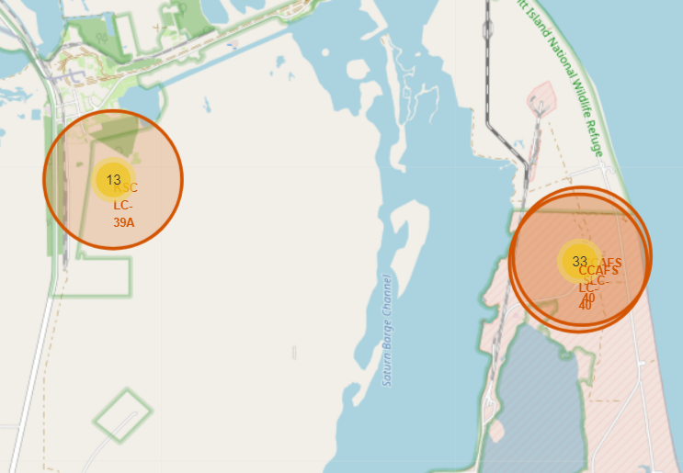
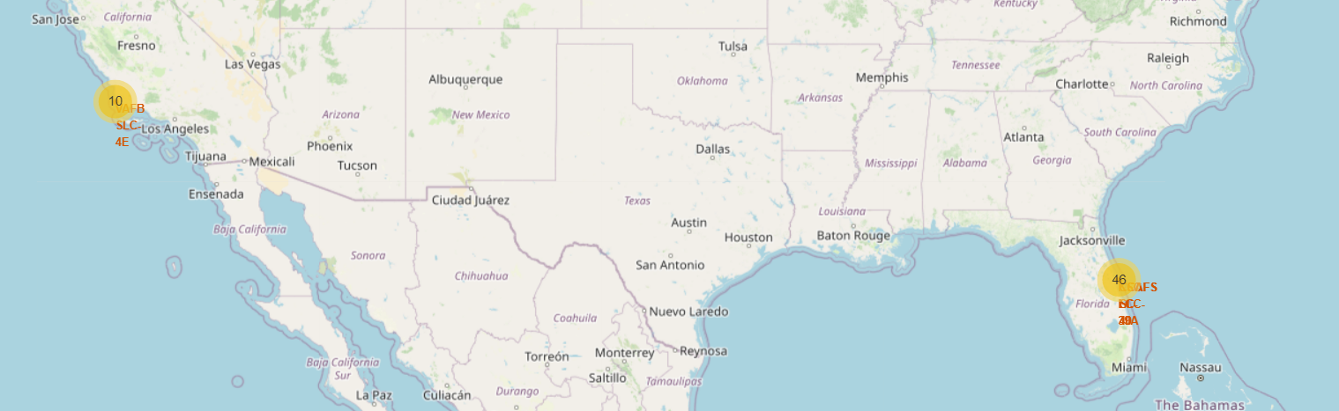
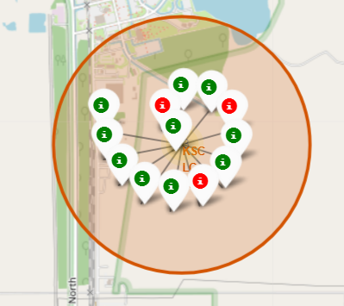
Launch Outcomes by Site
Green Markers indicate successful landings and red indicates Markers indicate failed landings.

Slide 40
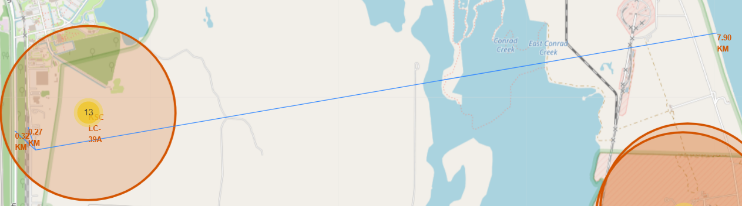
Logistics and Safety
Launch site KSC LC 39A is 7.9km away from coastline, 0.27km away from railroad, and 0.32km away from highway and relatively far away from residential cities.

Slide 41

Section 4

Slide 42
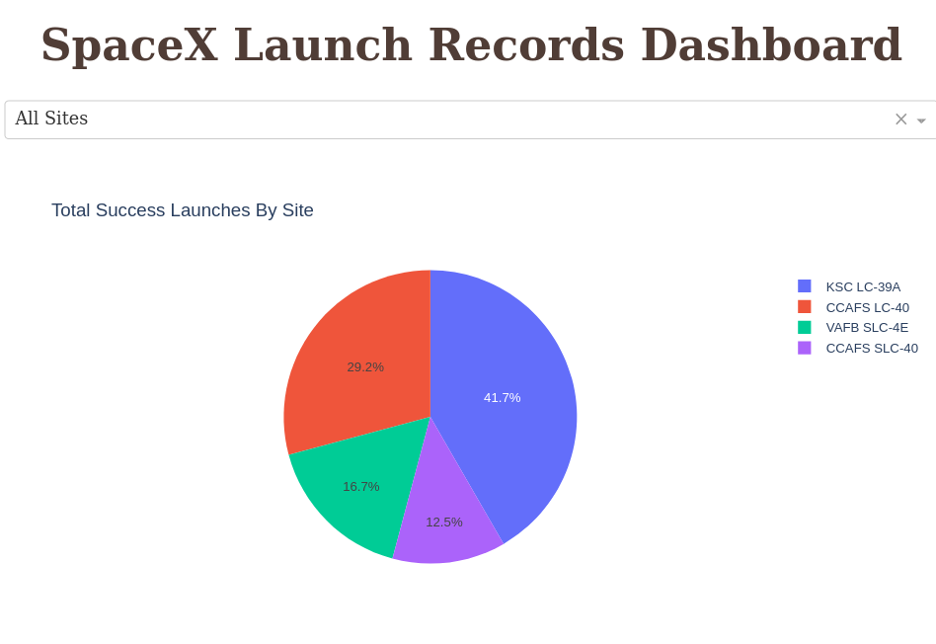
Successful Launches by Site
Selection of launch sites seems to be an important factor for success.

Slide 43
Launch Success Ratio for KSC LC 39A
76.9% of launches are successful in this site.

Slide 44
Payload vs. Launch Outcome for All Sites
Payloads under 6,000 kg and FT boosters are the most successful combination.
There’s not enough data to estimate risk of launches over 7,000 kg

Slide 45

Section 5

Slide 46
Classification Accuracy
Four classification models were trained, and their accuracies were plotted.
Decision Tree model had the highest accuracy of 88.75%

Slide 47
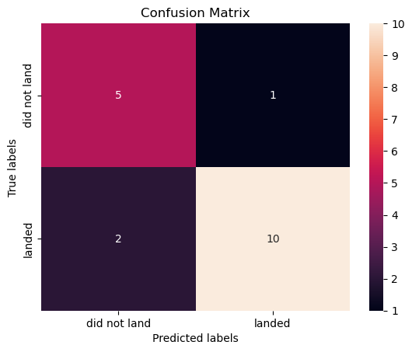
Confusion Matrix of Decision Tree Classifier
Confusion Matrix of Decision Tree Classifier proves the accuracy of the model is high by showing high values for True Positives and True negatives.

Slide 48
Conclusions
Data were procured from different sources. They were cleaned and scaled to provide statistically accurate results.
The best launch site is KSC LC 39A with 77.27% landing success rate.
Launches above 7,000 kg are less risky.
Although most of mission outcomes are successful, successful landing outcomes seem to improve over time, according the evolution of processes and rockets.
VLEO missions seem to be a business growth opportunity, having both high success rate and increased customers in the recent period.
Decision Tree Classifier can be used to predict successful landings and increase profits.

Slide 49


